Slide 1
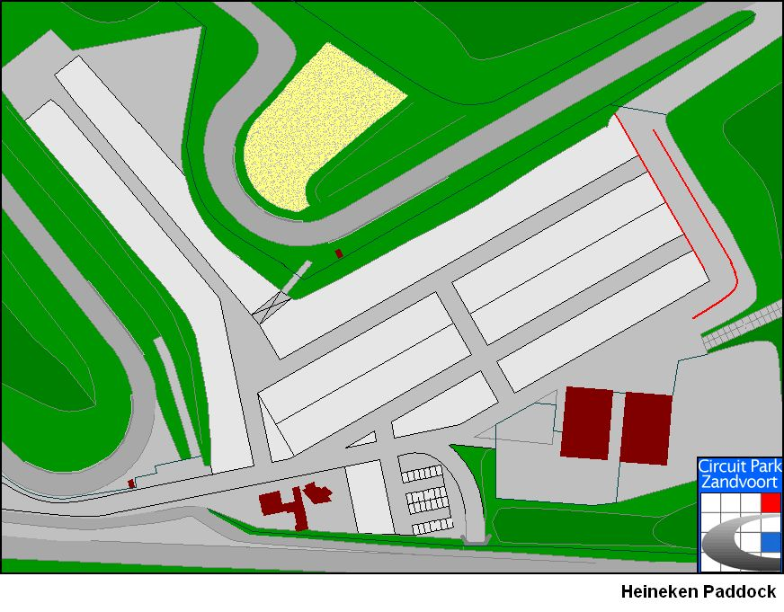
Versie 07-03-2017
MG Triumph Comp
Karting
MG Triumph Comp
NK GTTC
PRE
GRID
HARC NK 82/90
402
402
NKHTGT
concours
NKHTGT
402
TC
Scrutineering
PARC
FERMEE
402
Entrance
Paddock 2
Only race cars facing the drive way, service cars and motorhomes must be parked in the back
Trailers must be parked on parking C paddock office

